Slide 1
Git-hub source code management
By
kirubanand

Slide 2
Why use something like Git?
GitHub is a Git repository web-based hosting service, which offers all of the distributed revision control and source code management (SCM) functionality of Git as well as adding its own features.
Git is version control software, which means it manages changes to a project without overwriting any part of that project.
Say you and a coworker are both updating pages on the same website. You make your changes, save them, and upload them back to the website. So far, so good.

Slide 3
Why use something like Git?
The problem comes when your coworker is working on the same page as you at the same time. One of you is about to have your work overwritten and erased.
A version control application like Git keeps that from happening. You and your coworker can each upload your revisions to the same page, and Git will save two copies.
Later, you can merge your changes together without losing any work along the way. You can even revert to an earlier version at any time, because Git keeps a “snapshot” of every change ever made.

Slide 4
Why use something like Git?
The problem with Git is that it’s so ancient that we have to use the command line—or Terminal if you’re a Mac user—in order to access it, typing in snippets of code like ‘90s hackers.
This can be a difficult proposition for modern computer users. That’s where GitHub comes in.

Slide 5
Installation process in windows
Visit to following url http://git-scm.com/download/win.
The installer includes a command line version of Git as well as the GUI.
Execute exe file and install.
Then type git help –a to view options.

Slide 6
To create a new repository on the command line
Mkdir directory
git init
Then create a repo manually with same name in remote.
git add *
git commit -m “message"
git remote add origin https://github.com/kkiruban/dumping-file-repo.git
git push -u origin master

Slide 7
Basic commands used in git hub create & clone Add & remove
Create a new repository – git init
Clone local repository – git clone /path/to/repository
Clone remote repository – git clone username@host:path/to/repository
Add changes to index –git add (path of the file)
Add all changes to index – git add *
Remove/delete – git rm (path of the file)

Slide 8
Basic commands used in git hub commit & synchronize
commit changes – git commit –m “message”
Push changes to remote repository –git push –u origin master
Connect local repository – git remote add origin<server>
Update local repository – git pull or git pull origin master.

Slide 9
Basic commands used in git hub branches & merge
Create a new branch – git checkout –b branchname master
Switch to branch – git checkout branchname
Delete branch – git branch –d branchname
Push branch to remote repository – git push –u origin branch
Merge changes from another branch – git merge <branch>

Slide 10
git-hub advantages
Git is much more than a version control system, it can be used as CMS, workspace manager
Git is a distributed revision control system with an emphasis on speed,data integrity, and support for distributed, non-linear workflows.
every Git working directory is a full-fledged repository with complete history and full version-tracking capabilities, independent of network access or a central server
Git branches is much more easier & fun. You can quickly switch between branches from the same working directory. It helps finding un-merged branches and also help merging files fairly easily & quickly.

Slide 11
git-hub advantages
Flexible solutions, have code which is easily adaptable ion the case of changes.
Offers extensibility and flexibility for individual customization.
Self-explaining, straight-forward solutions
Code is easy to maintain
Can avoid complexity

Slide 12
difference betwwen git and svn
GIT is distributed, SVN is not:
This is by far the *core* difference between GIT and other non-distributed version control systems like SVN, CVS etc. If you can catch this concept well, then you have crossed half the bridge. To add a disclaimer, GIT is not the first or only distributed VCS(version control system) currently available. There are other tools like Bitkeeper, Mercurial etc. which also work on distributed mode. But, GIT does it better and comes with much more powerful features.
GIT like SVN do have centralized repository or server. But, GIT is more intended to be used in distributed mode which means, every developers checking out code from central repository/server will have their own cloned repository installed on their machine. Let’s say if you are stuck somewhere where you don’t have network connectivity, like inside the flight, basement, elevator etc. , you will still be able to commit files, look at revision history, create branches etc. This may sound trivial for lot of people but, it is a big deal when you often bump into no-network scenario.

Slide 13
GIT is distributed, SVN is not:
And also, the distributed mode of operation is a biggest blessing for open-source software development community. Instead of creating patches & sending it thro emails, you can create a branch & send a pull request to the project team. It will help the code stay streamlined without getting lost in transport. GitHub.com is an awesome working example of that.
There were some rumors that the future version of subversion will be working on distributed mode. But, it’s still an unknown at this point.

Slide 14
difference betwwen git and svn
GIT stores content as metadata, SVN stores just files:
Every source control systems stores the metadata of files in hidden folders like .svn, .cvs etc., whereas GIT stores entire content inside the .git folder. If you compare the size of .git folder with .svn, you will notice a big difference. So, the .git folder is the cloned repository in your machine, it has everything that the central repository has like tags, branches, version histories etc.

Slide 15
Centralized Workflow
In centralized systems, there is generally a single collaboration model–the centralized workflow.
One central hub, or repository, can accept code, and everyone synchronizes their work to it.
A number of developers are nodes – consumers of that hub – and synchronize to that one place.

Slide 16
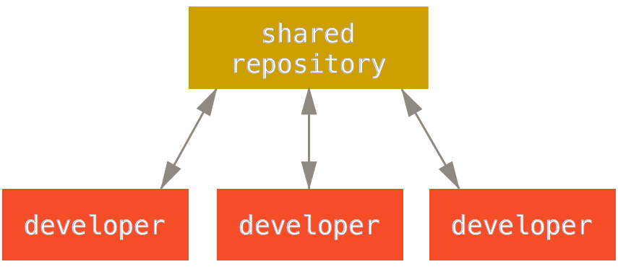
Centralized Workflow

Slide 17
Centralized Workflow
This means that if two developers clone from the hub and both make changes, the first developer to push their changes back up can do so with no problems.
The second developer must merge in the first one’s work before pushing changes up, so as not to overwrite the first developer’s changes.
This concept is as true in Git as it is in Subversion (or any CVCS), and this model works perfectly well in Git.

Slide 18
Centralized Workflow
If you are already comfortable with a centralized workflow in your company or team, you can easily continue using that workflow with Git.
Simply set up a single repository, and give everyone on your team push access;
Git won’t let users overwrite each other.
Say John and Jessica both start working at the same time. John finishes his change and pushes it to the server. Then Jessica tries to push her changes, but the server rejects them.
She is told that she’s trying to push non-fast-forward changes and that she won’t be able to do so until she fetches and merges.
This workflow is attractive to a lot of people because it’s a paradigm that many are familiar and comfortable with.

Slide 19
Centralized Workflow
This is also not limited to small teams. With Git’s branching model, it’s possible for hundreds of developers to successfully work on a single project through dozens of branches simultaneously.

Slide 20
For the following error in git: use command ---rm -f ./.git/index.lock
Error:
If no other git process is currently running, this probably means a git process crashed in this repository earlier. Make sure no other git process is running and remove the file manually to continue.

Slide 21
To set global email id -git config --global user.email your_email@example.com
git config --global user.email kirubaramasamy26@gmail.com.
To set global username - git config --global user.name “don"

Slide 22
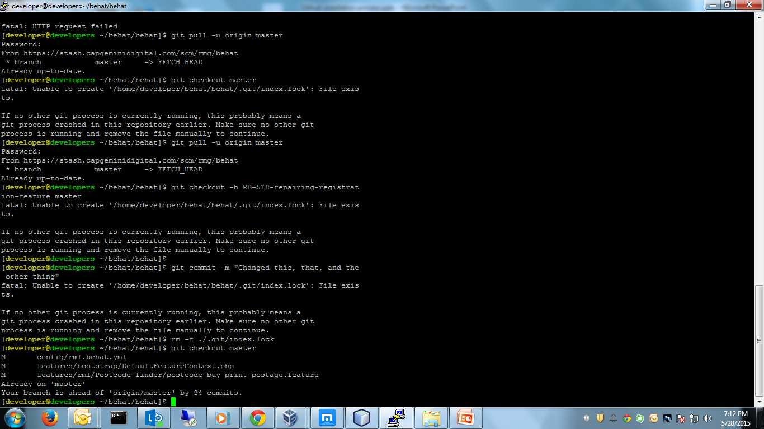
Changelles faced in github
Notes:
If you are getting a fatal error: Unable to create '/home/developer/behat/behat/.git/index.lock': File exists
If no other git process is currently running, this probably means a
git process crashed in this repository earlier. Make sure no other git
process is running and remove the file manually to continue.
Then type a command to remove- rm -f ./.git/index.lock

Slide 23
How to create a dependency for branch
git checkout -b RB-531-new-behat-scripts R B-531-improving-test-coverage-for-redirection-module

